Slide 1
Washington State CRC Task Force
January 27th, 2021

Slide 2
Welcome Back!!
AGENDA:
Welcome and Brief Historical Update
What happened to our work before COVID?
High Level “State” of the State
Where are we now?
Getting Back to Work
Where do we go from here?
March – CRC Awareness Month

Slide 3
“State of the State”
Where are we now?

Slide 4
Getting Back to Work
Where Do we go from here?

Slide 5
CRC Awareness Month
After a lengthy pause due to the pandemic, there’s renewed engagement to work to work on CRC Screening

Slide 6
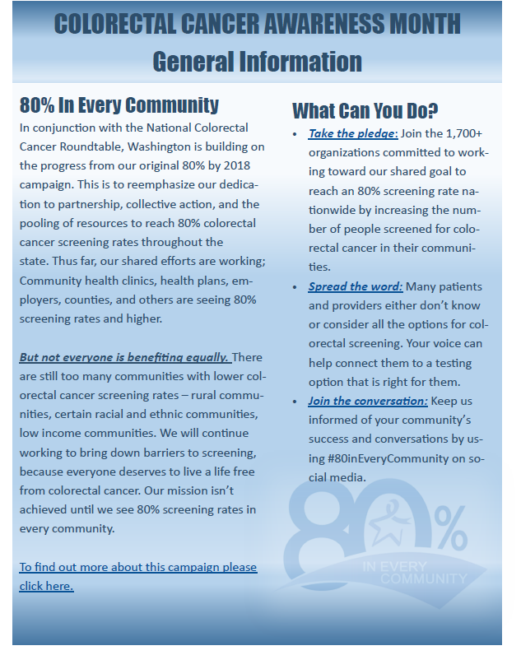
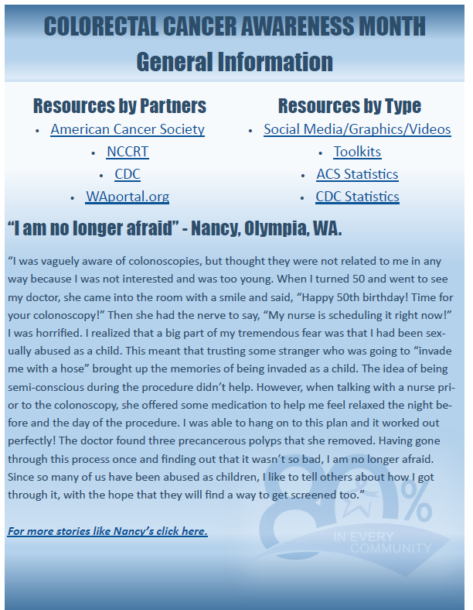
2020
Materials

Slide 7
Next Steps:
Priorities and Action Plans for Task Force
Task Force Meeting in Spring: April/May
Questions, Updates, or Resources to Share

Slide 8
Thank You!

